Slide 1
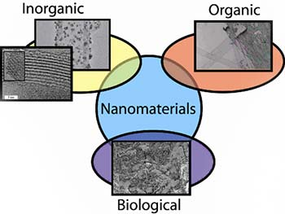
Introduction to Nanomaterials –
An Elementary Level Module
Tatiana Stine – Nano@Illinois RET 2016
Notes:
NOTE:
To change the image on this slide, select the picture and delete it. Then click the Pictures icon in the placeholder to insert your own image.

Slide 2
Purpose and Resources
Purpose:
The purpose of this module is to expose elementary students to the world of nanoscale and nanomaterials, particularly graphene.
This is not a mastery required unit.
It has been structured and organized as an introductory unit focusing on understanding the nanoscale and working with nanomaterials for young children at the elementary age.
Resources:
There are lessons and activities blended from other nanotechnology resources and websites.
The intention is to bring together these lessons and activities into a cohesive series of lessons.
All outside resources have been properly referenced.

Slide 3
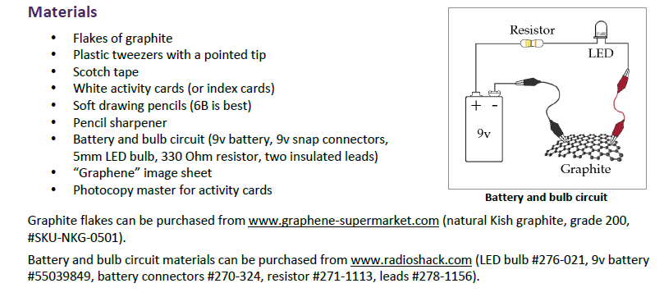
Organization and Materials
Organization:
Each lesson has its own folder to include the lesson plan (teacher guide), student activities, accompanying worksheets or posters, and all other reference material.
Each lesson is designed to be completed in one longer lesson (60 minutes) or two shorter lessons (30 minutes each), that can be adjusted according to the age level needs or differentiation.
The recommended length of the unit is one week, including the pre-assessment and post assessment.
Materials:
All materials are available online and were purchased on Amazon or through the suggested venues that are identified in the resources.

Slide 4
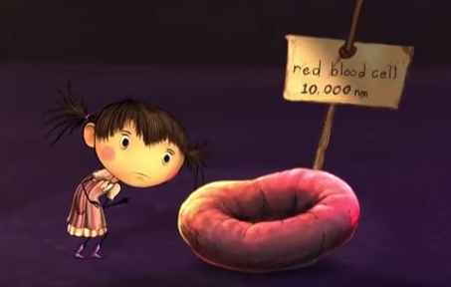
Lesson One – Introduction to Nanoscale Materials
: This lesson provides an introduction to the concepts of Nanoscale materials and the potential uses for nanotechnology.
Students explores how nanotechnology has impacted the world, and how engineers have to consider the ramifications of working at a very small scale.
Students are introduced to working with materials that cannot be seen with the natural eye.
Students also explore the size of nanoscale, comparing various items to understand the concepts of Nano size and scale up activities.
What is Nano?

Slide 5
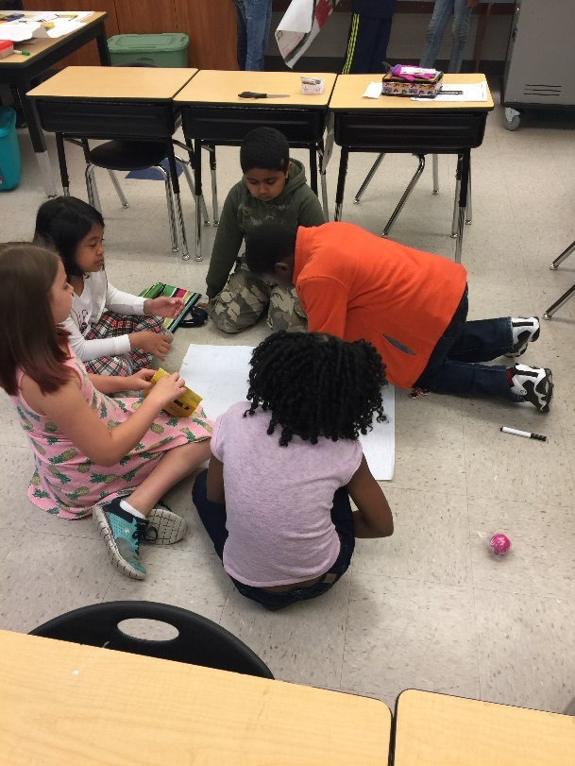
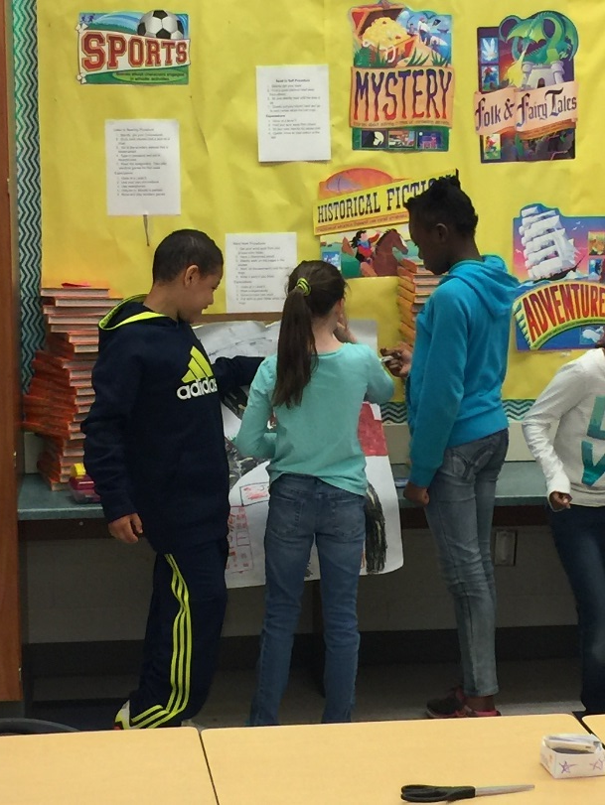
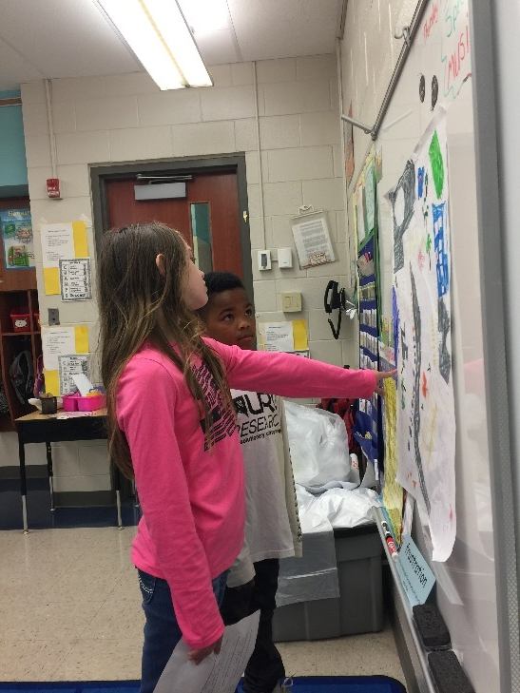
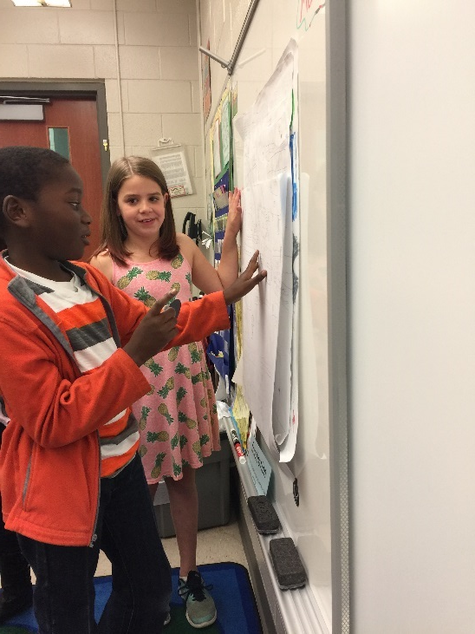
3rd Graders working on and presenting their Nano Posters

Slide 6
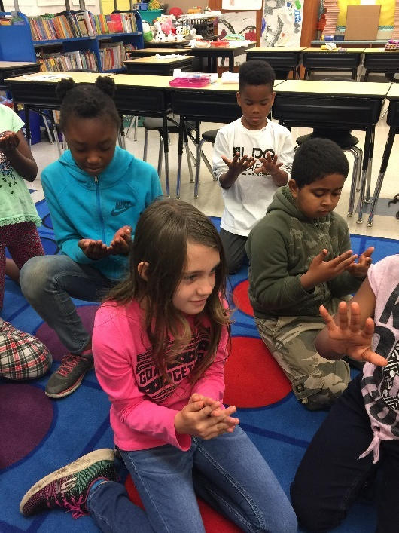
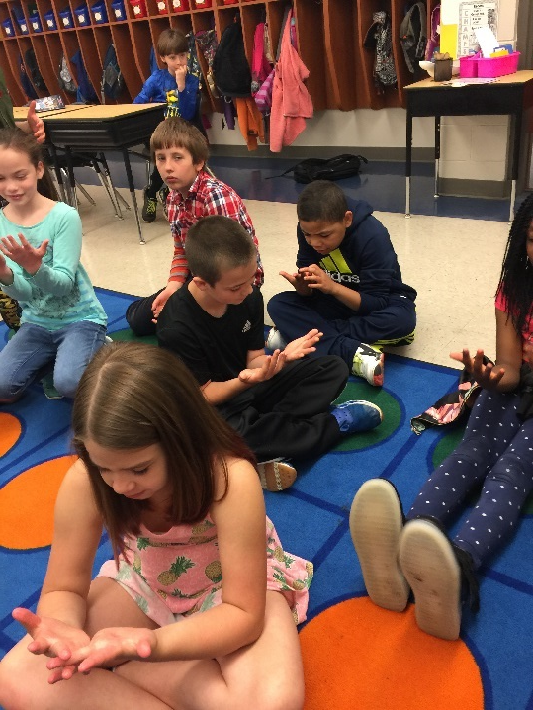
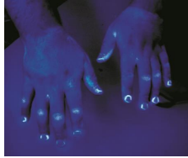
Lesson Two – Working with Nanoscale Materials
This lesson provides a hands-on activity focusing on observations made on a nanoscale and working with nanomaterials within biology (germs, bacteria) – GLO GERM Activity
Students explore biological nanomaterials through the GLOGERM lesson plan and activity. The emphasis will be to provide experience working with materials that cannot be seen with the natural eye.
Students also explore the size of nanoscale, comparing various items to understand the concepts of Nano size and scale up activities.

Slide 7
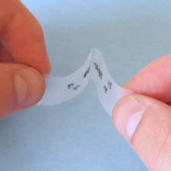
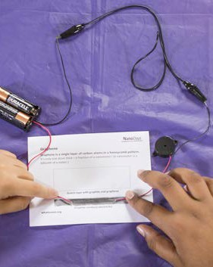
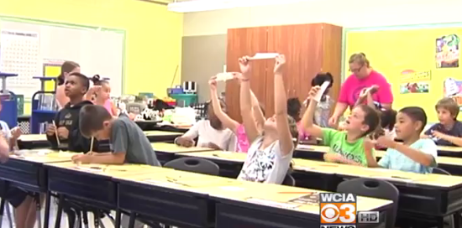
Lesson Three - Graphene
This lesson provides a hands-on activity focusing on exploring and working with graphene.
Students explore graphite and the process for getting to Graphene.
Students will examine the electrical conductivity of Graphene.
3rd Grade Graphene - WCIA

